Slide 1
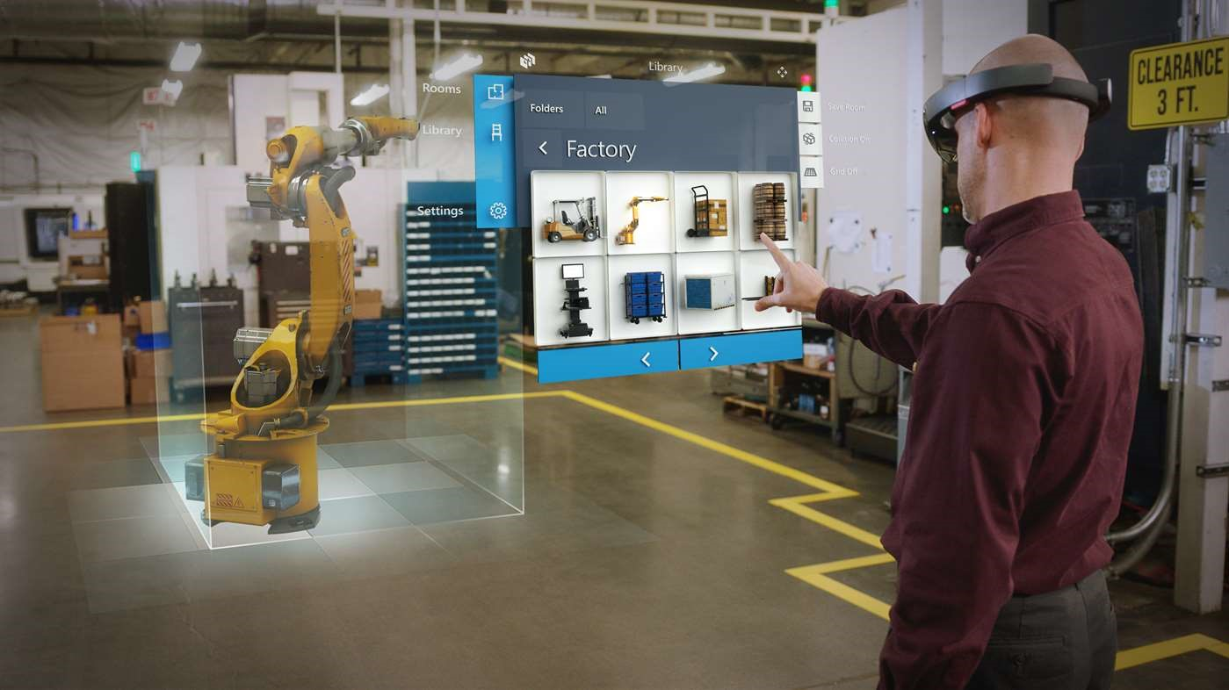
Mixed reality
Mixed reality is the merging of real and virtual worlds to produce new environments and visualizations, where physical and digital objects co-exist an

Slide 2
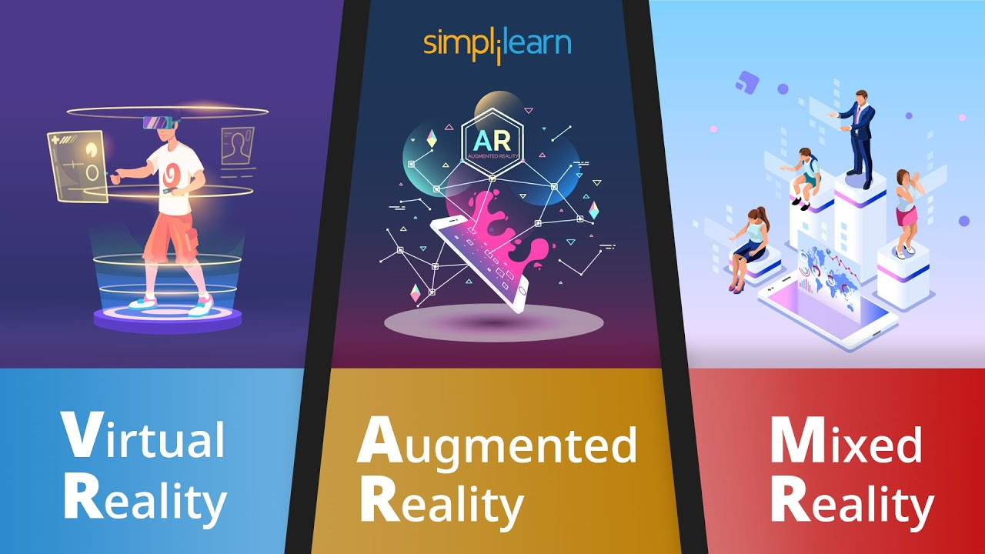
Definition

Slide 3
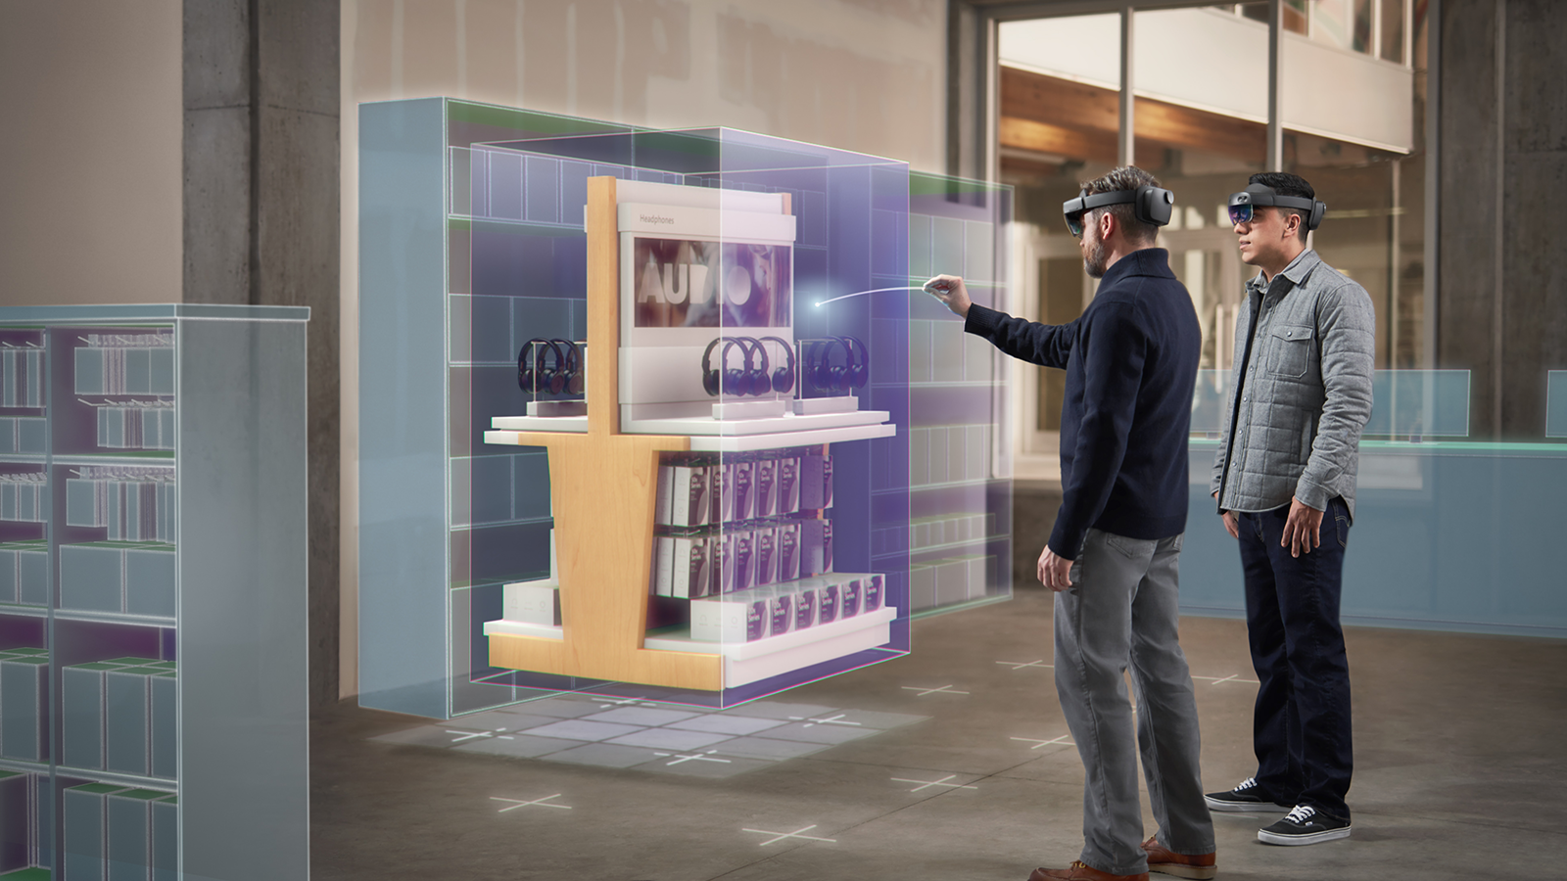
Applications
Mixed reality has been used in applications across fields including design, education, entertainment, military training, healthcare, product content m

Slide 4
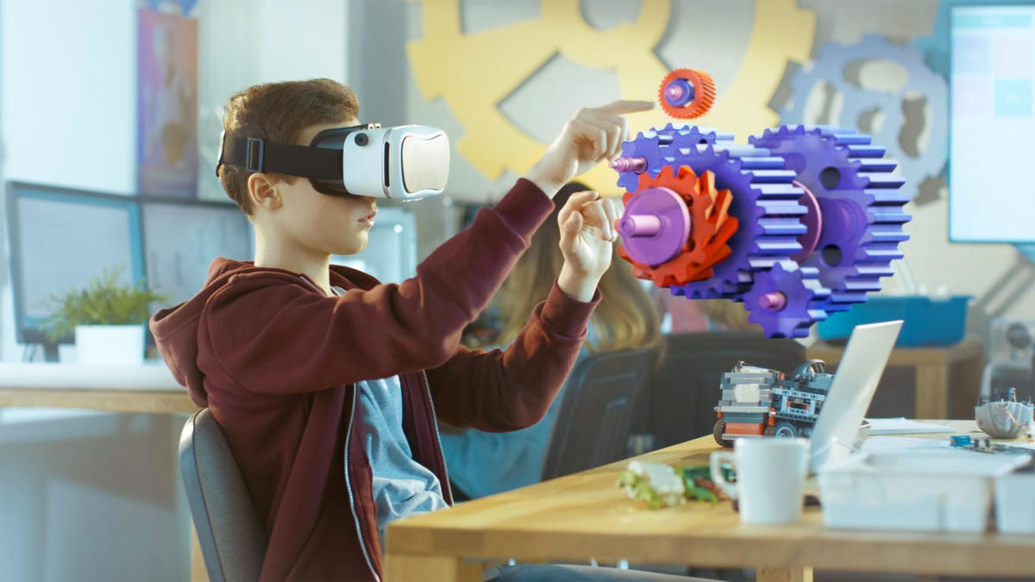
Display technologies
Mixed reality refers to the intertwining of the virtual world and the physical world.

